Slide 1






















韵
动
格
点
LumiTap
COMMUNITY‑DRIVEN RHYTHM GAME PLATFORM
Presenter：Wang Cheng
Time：2025.11.12

Slide 2

CONTENTS
01_ Introduction
02_ Overall Description
03_ Specific Requirements
04_ Interface Prototype
05_ Function Description and AcceptanceVerification Standards

Slide 3
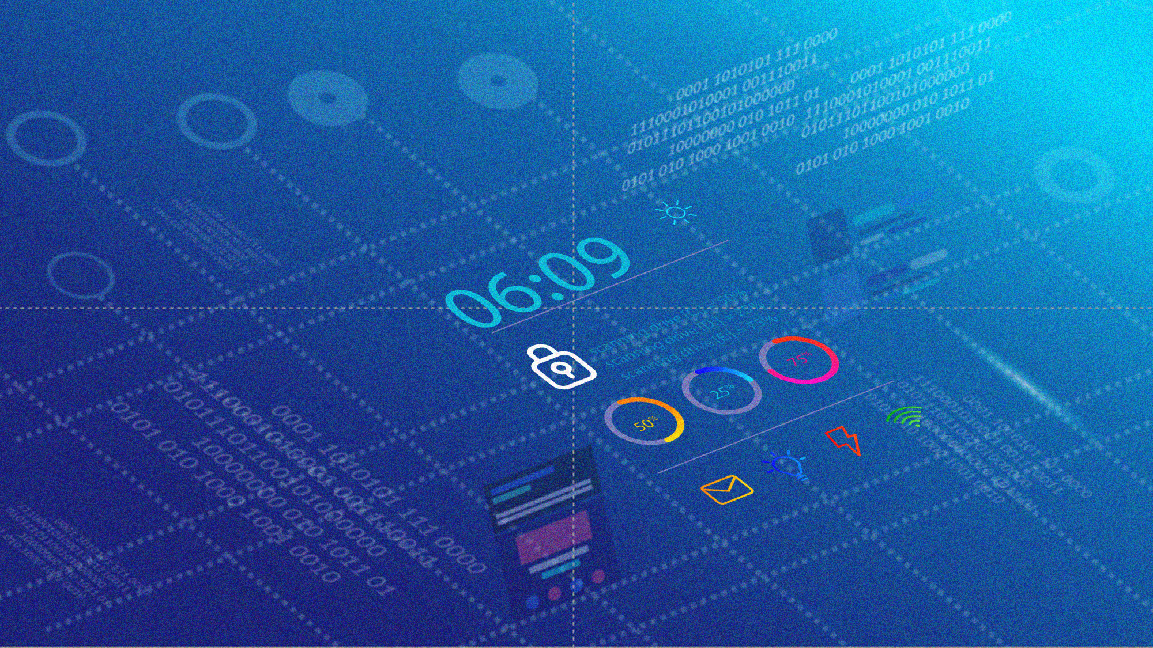

1
Introduction

Slide 4
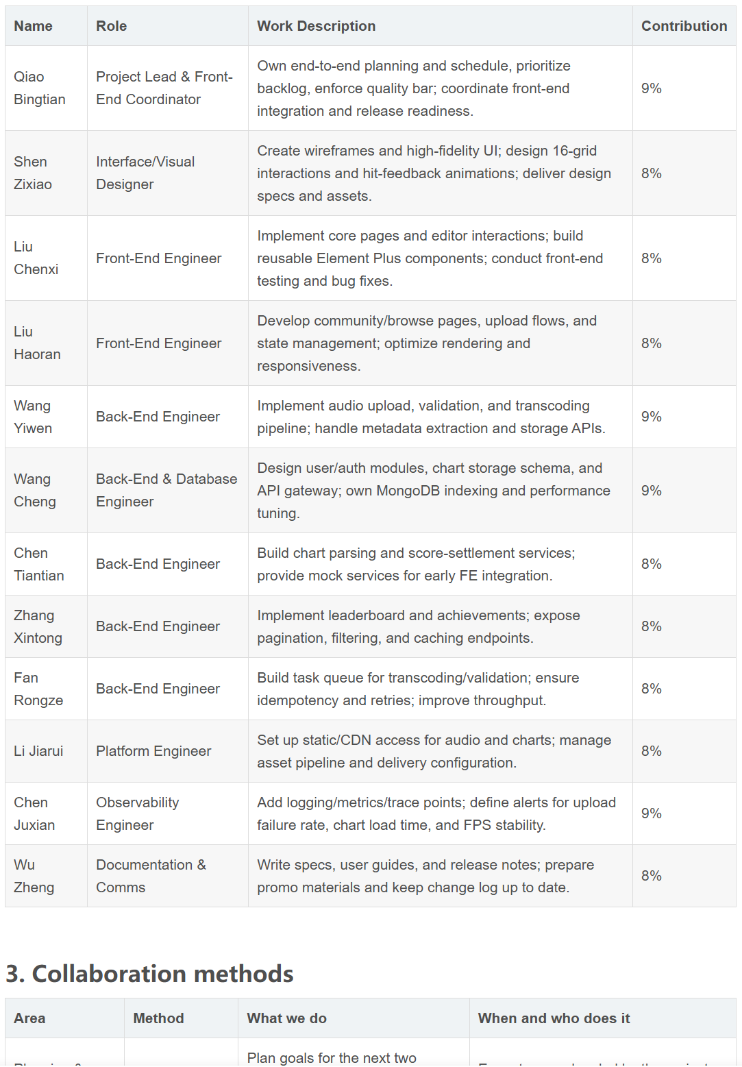
01_INTRODUCTION——Teamwork

Slide 5
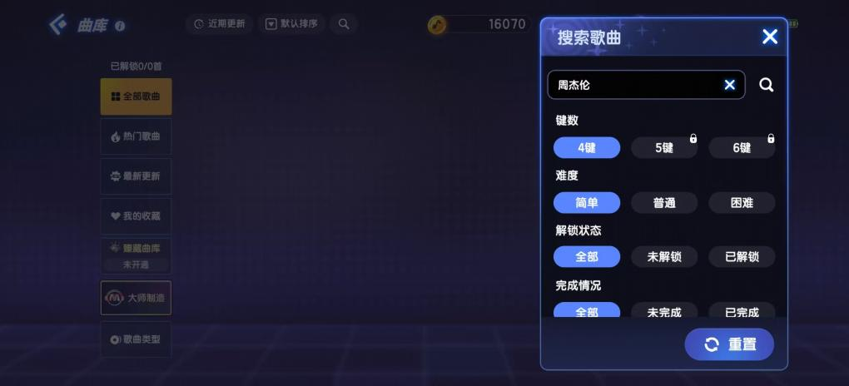
01_INTRODUCTION——Background
Market Gap
Product Definition
The project addresses a market gap for “classic gameplay + open community” in rhythm/ MMO spaces and the lack of freedom to choose, edit, and share music resources.
LumiTap is a community ‑ interactive rhythm ‑ game platform that combines the 4×4 grid tap gameplay of classic arcade titles with a modern user‑generated‑content (UGC) ecosystem.
It includes an in‑game chart editor, sharing, and leaderboards to form a sustainable creator / player‑driven ecosystem for rhythm‑game fans, creators, and ACG communities.
YES
no

Slide 6
2
Overall Description

Slide 7
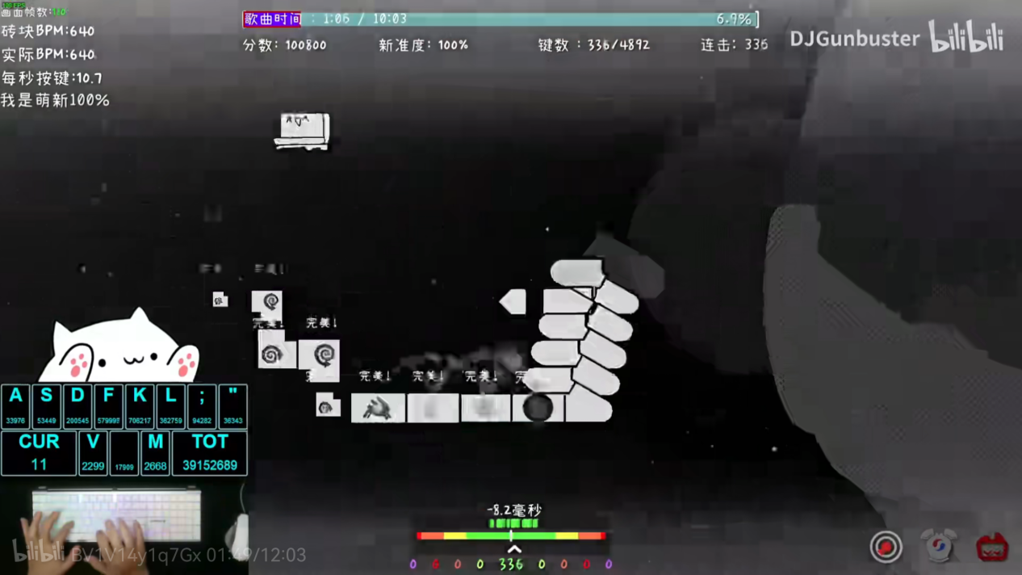
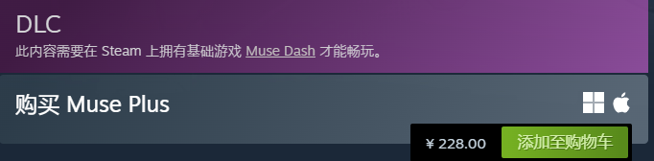
02_ OVERALL DESCRIPTION——Project Objectives
Development Intention
Application Goals & Scope
Leverage database and UI technologies to deliver a smooth UI and the novel 4×4 grid tap gameplay.
Foster a compact, high-quality player community and build a complete score-creation ecosystem.
Core Functional Modules:
Gameplay: 4×4 grid rhythm tapping with judgment system and JUBEAT-style scoring.
Chart Editor: Graphical interface for importing audio, designing timing, and setting difficulty.
Community Platform: Upload/download charts, comments, ratings, global/friends leaderboards, and content filters.
Target Users: Former JUBEAT/arcade players; osu!, Phigros community enthusiasts; independent musicians and fan creators; general ACG fans and casual players.
Platform Scope: The initial version targets PC (Windows/macOS), with potential future expansion to iOS/Android.

Slide 8
02_ OVERALL DESCRIPTION——Product Prospects
The infrastructure supports future iterations such as online battles, AI chart recommendations, and cross-platform sync; commercialization (donations, creator subscriptions) can sustain operations while keeping the core free.
Under the UGC model, the music library grows over time, reducing reliance on official updates and forming a virtuous cycle: "More players → More content → Attracts more players".
02
04
Industry
Influence
Community-Driven Growth
Sustainable Content Ecosystem
Filling the gap of "classic gameplay + open community," the project can become a benchmark for community-driven rhythm games and advance user-participation models.
Technical Scalability
An active community spawns sub-cultures (e.g., chart-making tutorials, events). Creator-incentive programs (virtual rewards, exposure) accelerate ecosystem maturity.
01
03

Slide 9
3
Specific Requirements

Slide 10
03_Specific Requirements — Properties--Availability
02
04
Core services—user authentication, beatmap upload, and gameplay synchronization—operate independently so a failure in one does not impact others
Mobile client supports offline play for downloaded beatmaps; results auto‑sync when connectivity is restored
01
03
Target 99% uptime for the game and server components, ensuring access to accounts, scores, and beatmaps at all times
Use redundant storage
for beatmaps and user data to prevent loss

Slide 11
03_Specific Requirements—Properties--Security
User Authentication
Data Transmission
Access Control
Secure registration/login with hashed passwords (e.g., SHA‑256 or bcrypt)
All client–server communication uses HTTPS.
Only authenticated users can upload beatmaps or modify their scores; admins can remove inappropriate content
Privacy Protection
Backup & Recovery
Data Integrity
Verify beatmaps and music files (e.g., checksums) to prevent tampering or malware
Store personal data (email, password) securely and keep it hidden from other users
Periodically back up accounts, scores, and uploaded content to avoid loss from server failures

Slide 12
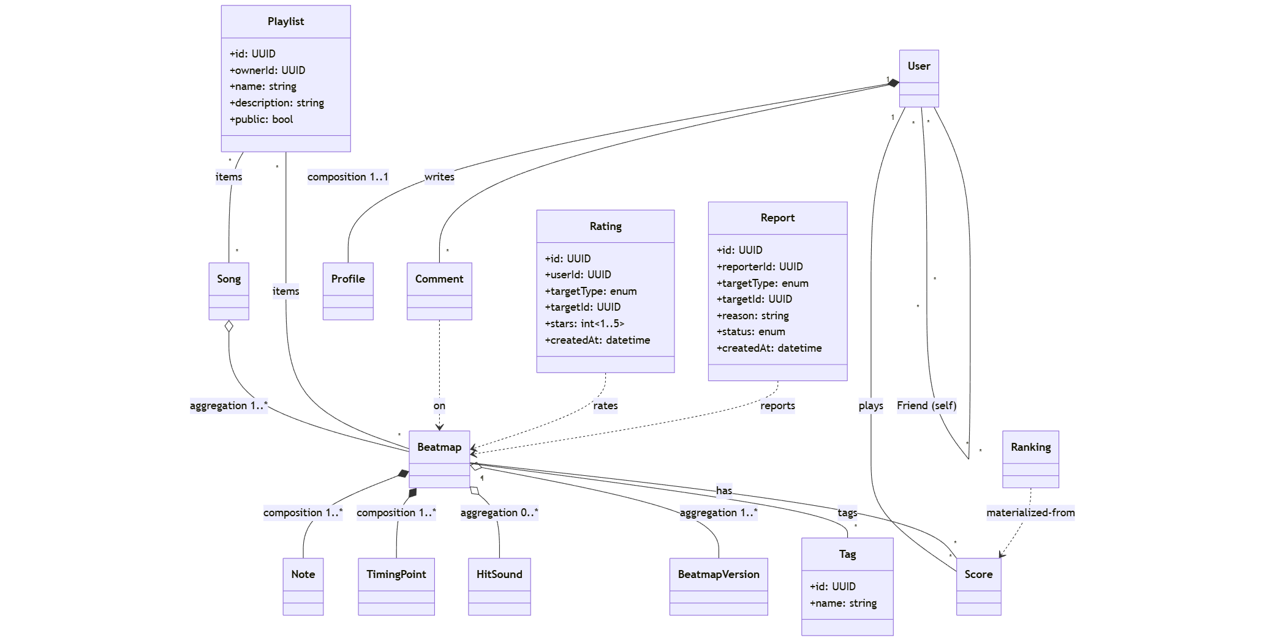
03_Specific Requirements—Class Diagram-- Domain Model

Slide 13
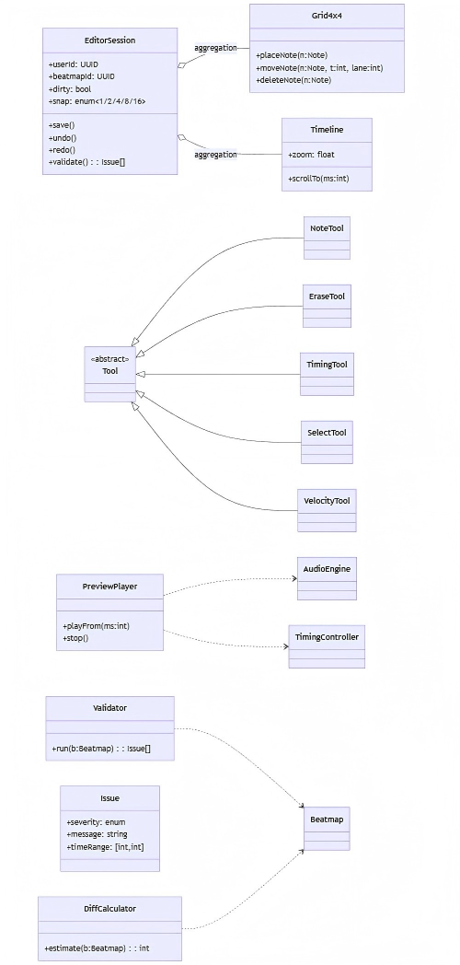
03_Specific Requirements—Class Diagram-- Music Editor

Slide 14
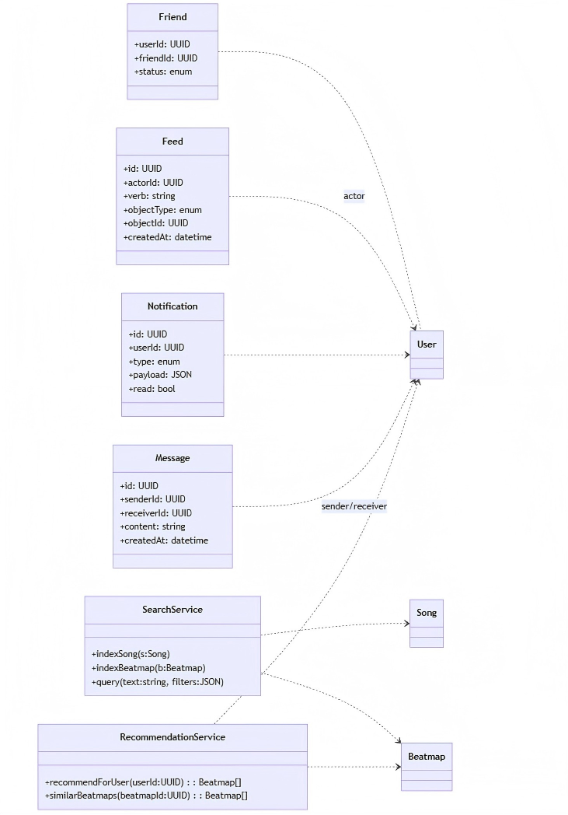
03_Specific Requirements—Class Diagram-- Community and Social

Slide 15
4
Interface Prototype

Slide 16
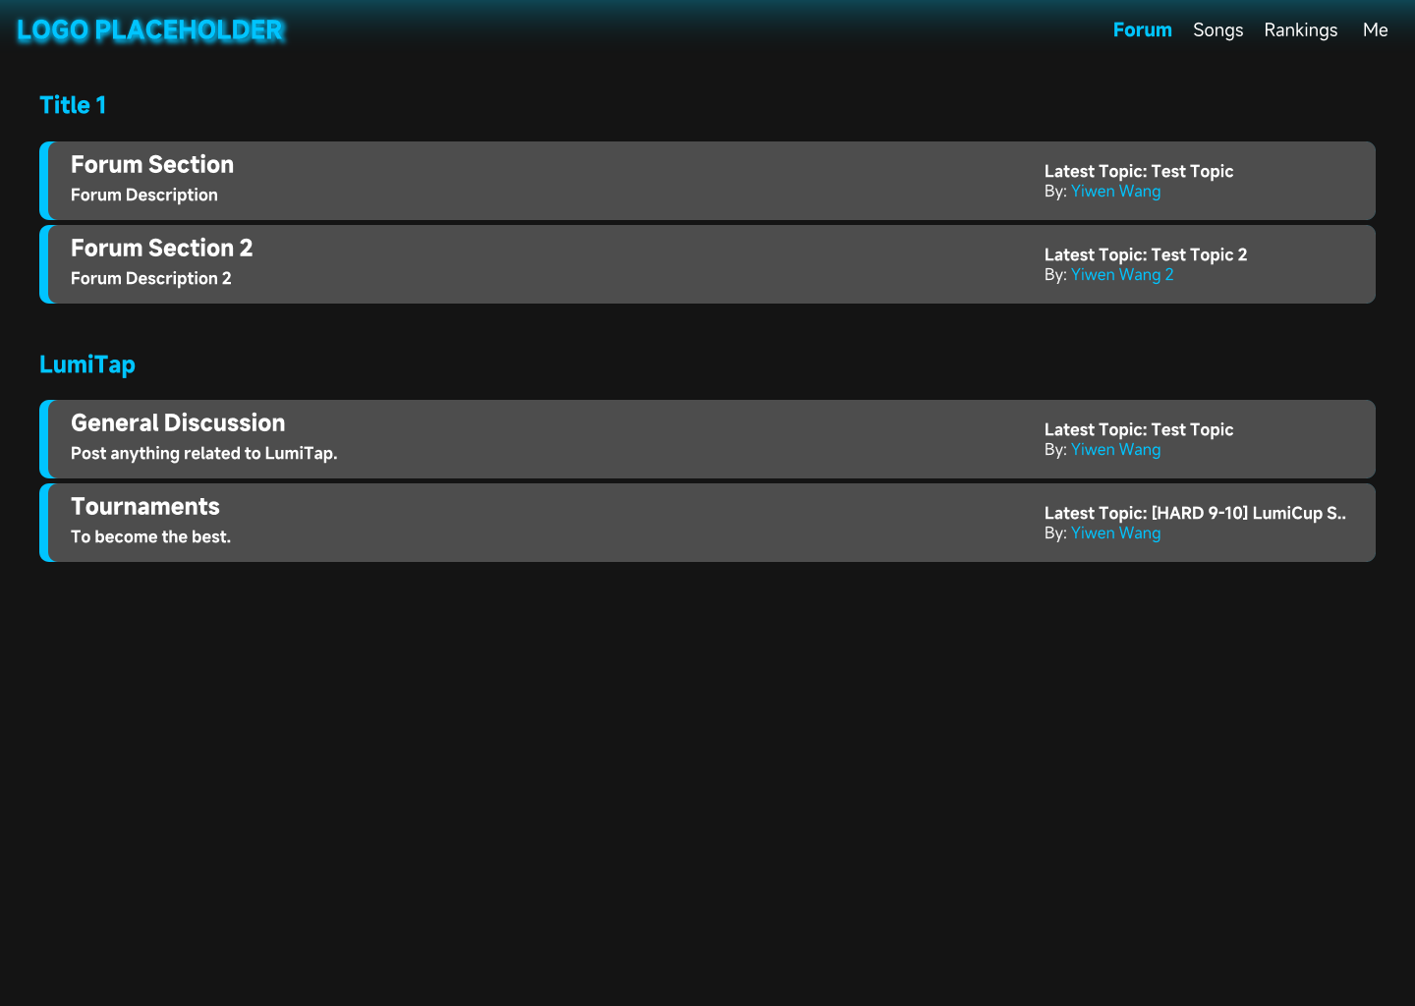
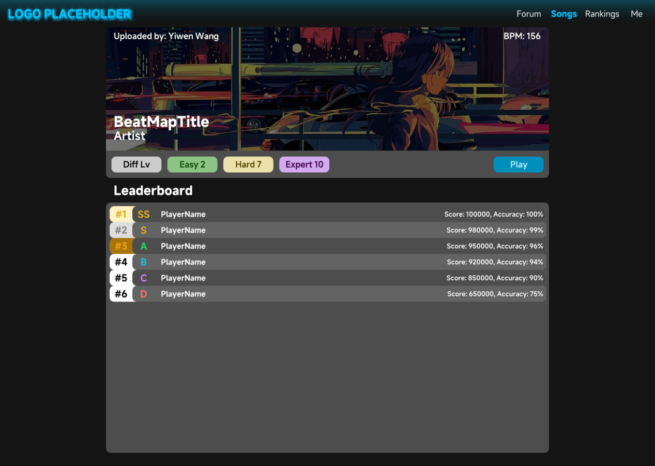
04_Interface Prototype
Homepage
Song selection interface

Slide 17
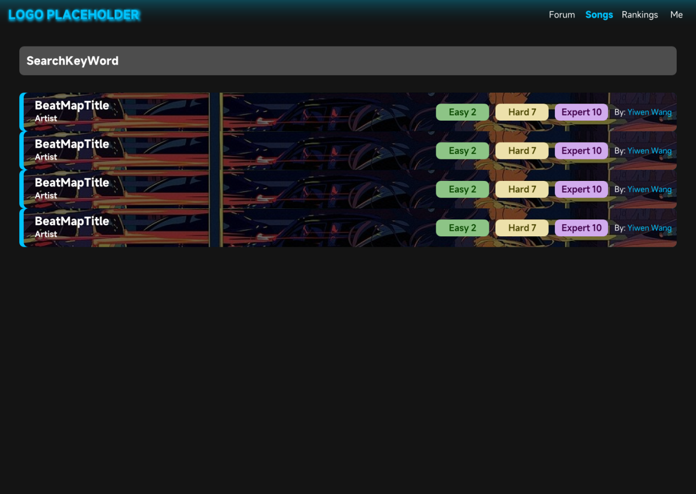
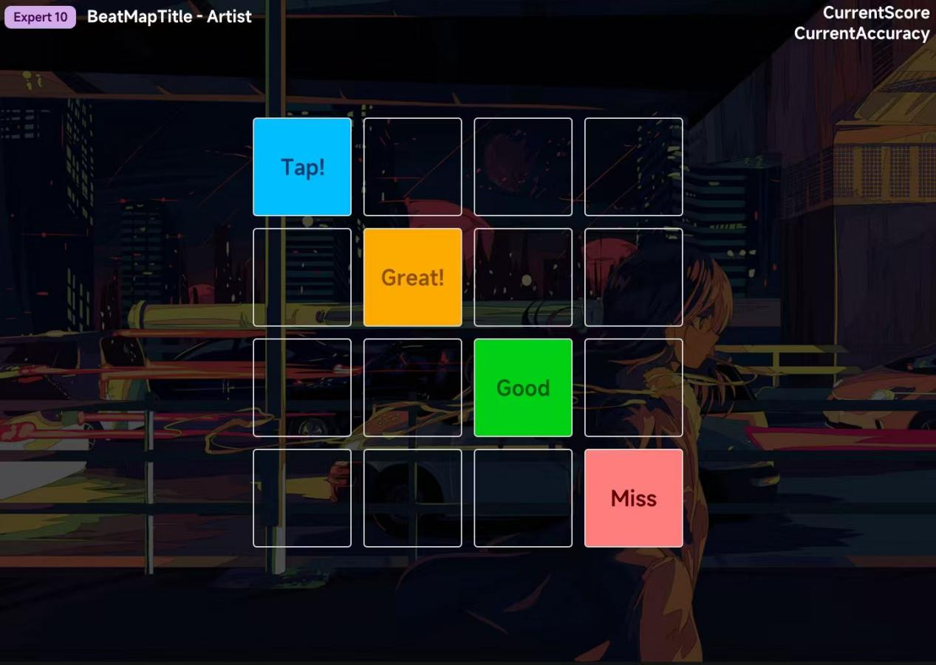
04_Interface Prototype
Song search interface
Game interface

Slide 18
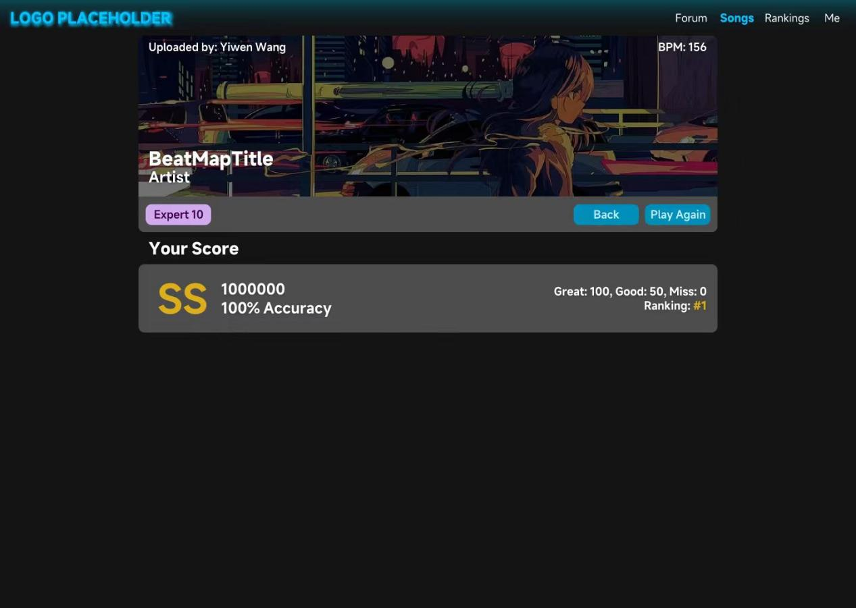
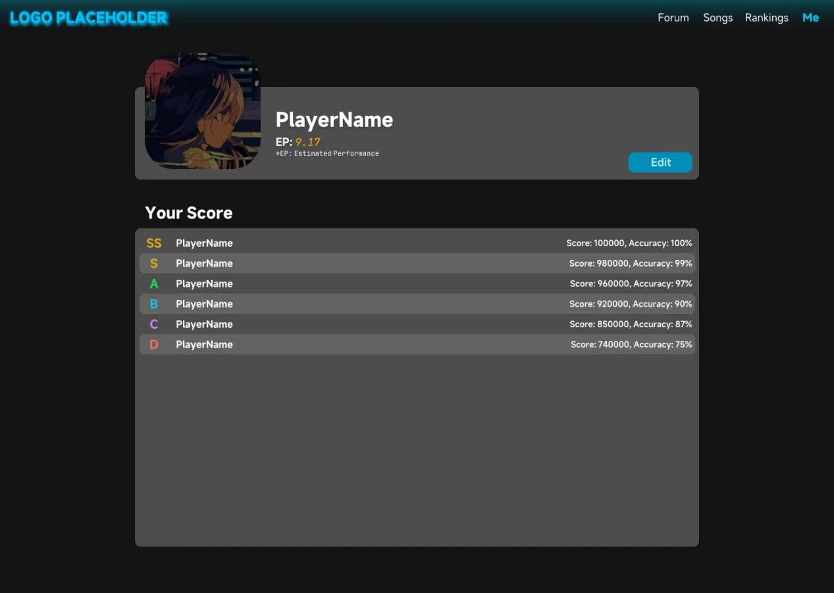
04_Interface Prototype
Score interface
Personal interface

Slide 19
5
Function Description and
Acceptance Verification Standards

Slide 20
05_Function Description and Acceptance Verification Standards
--Detailed Function Description
ONE
TWO
THREE
LumiTap is a mobile rhythm game for the general public, easy to operate, and supportive of player‑generated content.
Gameplay is based on a 4×4 grid; players tap sync to the beat and receive real‑time feedback and scoring.
The project includes registration/login, score recording, and leaderboards; players can upload music and charts, browse and share in the community.
01
02
03
YES
no
YES
no
YES
no

Slide 21
05_Function Description and Acceptance Verification Standards
--Input and Output Format
Module | Input | Output
User Registration | JSON: {username, email, password} | JSON: {status, message, userId}
User Login | JSON: {email, password} | JSON: {status, token, userInfo}
Music Upload | FormData: {file, coverImage, title} | JSON: {status, musicId, url}
Chart Upload | JSON: {musicId, chartData} | JSON: {status, chartId}
Game Score | JSON: {userId, musicId, score, accuracy, combo} | JSON: {status, rank}
Community Comment | JSON: {userId, musicId, comment} | JSON: {status, message}
Each module uses standardized JSON or FormData for input and output, defining clear data structures for communication.

Slide 22
05_Function Description and Acceptance Verification Standards
--Interface Acceptance Criteria
Endpoint | Method | Acceptance Criteria
/api/user/register | POST | 201 on success; 409 if duplicate; 400 for invalid params
/api/user/login | POST | 200 + Token on success; 401 for bad credentials
/api/music/upload | POST | 200 + file URL on success; 415 for format error
/api/game/score | POST | 200 on success; 500 for network/server error
/api/community/comment | POST | 201 on success; 400 if sensitive words detected
/api/community/list | GET | Returns paginated works; empty list if none
Each API endpoint has specific HTTP methods and status codes defined for scenarios like success, client errors, and server errors.

Slide 23
05_Function Description and Acceptance Verification Standards
--Functional Acceptance Criteria
Module | Item | Criterion
User Registration | Uniqueness | Email/username must be unique
User Login | Token Validity | Token valid for 7 days; re‑login after expiry
Music Upload | File Limits | No files >50 MB or non‑audio formats
Gameplay | Judgment Accuracy | Deviation ≤30 ms = Perfect; ≤70 ms = Good; >70 ms = Miss
Score Upload | Data Completeness | Must include userId, musicId, score, accuracy, combo
Community | Content Moderation | All comments reviewed; sensitive content auto‑filtered
Leaderboards | Update Frequency | Hourly updates; sortable by score/time
Error Handling | User Feedback | All errors return clear messages; no blank/stack traces
Each core module must adhere to specific business rules and limits, such as data uniqueness, file size, judgment logic, and update frequency.

Slide 24
韵
动
格
点
LumiTap
COMMUNITY‑DRIVEN RHYTHM GAME PLATFORM
Presenter：Wang Cheng
Time：2025.11.12

